Slide 1
Module 2
Register transfer logic: inter register transfer — arithmetic, logic and shift micro
operations. Processor logic design: - processor organization — Arithmetic logic unit - design of arithmetic circuit - design of logic circuit - Design of arithmetic logic unit - status register —design of shifter - processor unit — design of accumulator.
Explain different type of micro-operations?
Microoperations are the basic operations that can be performed by system on data stored in registers.
Microoperations are used by processors to complete their tasks to transfer data from one place to another.
Types of Microoperations
Inter register transfer micro-operations
Arithmetic micro-operations
Logic micro-operations
Shift micro-operations
inter register transfer micro-operations
These micro-operations do not change the information content when the binary information moves from one register to another.
The registers in a digital system are designated by capital letters. Examples A, B, R1, R2 etc.
The register that holds the address of the memory unit is called Memory Address Register (MAR). The cells of an n bit register are numbered in sequence from 1 to n, starting either from the left or from the right.
A register can be represented in 4 ways which is shown in the figure.

Slide 2
Explain different type of micro-operations?
Microoperations are the basic operations that can be performed by system on data stored in registers.
Microoperations are used by processors to complete their tasks to transfer data from one place to another.
Types of Microoperations
Inter register transfer micro-operations
Arithmetic micro-operations
Logic micro-operations
Shift micro-operations
inter register transfer micro-operations
These micro-operations do not change the information content when the binary information moves from one register to another.
The registers in a digital system are designated by capital letters. Examples A, B, R1, R2 etc.
The register that holds the address of the memory unit is called Memory Address Register (MAR). The cells of an n bit register are numbered in sequence from 1 to n, starting either from the left or from the right.
A register can be represented in 4 ways which is shown in the figure.

Slide 3
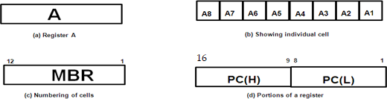
Figure (a) shows the most common way to represent a register is with a rectangular box in which name of the register is specified within the box.
In figure (b), it shows the individual cells of a register is assigned a letter with a subscript number and is marked from right to left.
The numbering of cells from right to left can be marked on top of the box as in figure (c).
A 16 bit register is partitioned into two parts, one high order part (H)
consisting of eight high ordered cells and one lower order part (L) consisting of eight low ordered cells as in figure (d).
Conditional transfer
The condition that determines when the transfer is to occur is called a control function. A control function is a Boolean function that can be equal to 0 or 1. The control function can be specified with the following statement:
x'T1: A←B
It means that the transfer operation be executed by the hardware only when the Boolean function x'T1=1.That is, variable x=0 and timing variable T1=1.
Example: Hardware implementation of a controlled transfer x'T1: A←B is shown in figure. Here A←B transfers the contents of register B to register
A. Contents of source register B do not change after the transfer.

Slide 4
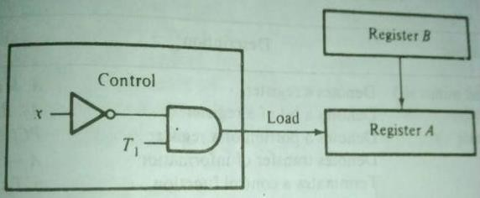
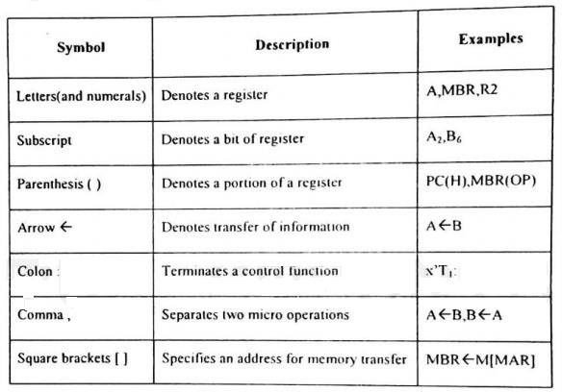
The basic symbols of the register transfer logic are listed in the following table.
Arithmetic Micro operations
The basic arithmetic micro-Operations are add, subtract, complement, and shift.
Add operation- It can be specified by the statement: F←A + B That is, the contents of register ‘A’ is added to the contents of register B and the sum

Slide 5
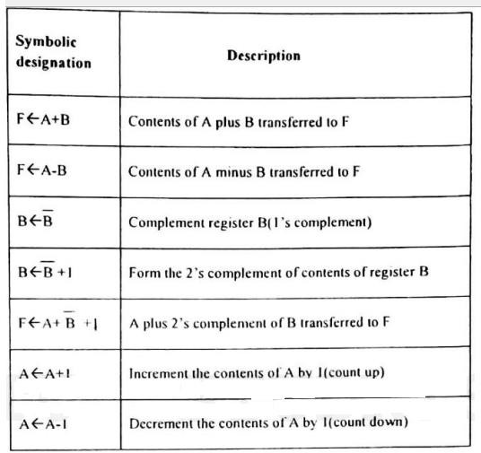
is transferred to register F. Here we require 3 registers and one digital function that addition operation such as parallel adder.
The other basic arithmetic operations the following table.
Arithmetic subtraction is most complementation and addition. That is,
often
implemented
through
F←A+B’+1
Adding 1 to the 1’s complement of B gives the 2's complement of B. When adding 2's complement of B to A it will results in minus operation (A-B).
Increment and decrement micro-operations are implemented with an up counter and down counter.
There must be a direct relationship between the statements written in a register transfer language and the registers and digital functions which are required for their implementation.

Slide 6
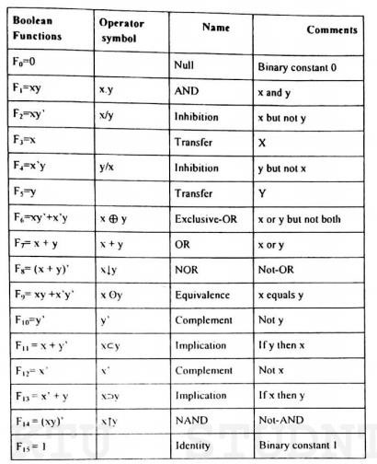
Logic Micro Operations
Logic micro-operations specify binary operations for a string of bits stored in registers. These operations consider each bit in the registers separately and treat it as a binary variable.
For example, consider the AND operation of A and B. Content of A is 1101 and content of B is 1010. Then,
1101(A)
1010(B)
A AND B will be 1000 (it will contain in the register F)
There are 16 different logic operations can be performed with two binary variables, as described in the below table.
All 16 logic operations can be expressed in terms of the AND, OR and complement operations. Special symbols are adopted for these three micro operations.

Slide 7



Shift Micro Operations
Shift micro-operations transfer binary information between registers in serial computers. They are also used in parallel computers for arithmetic, logic and control operations
Registers can be shifted to the left or right. There are no conventional symbols for shift. Here we are adopting the symbols shl and shr for shift left and shift right operations respectively.
Example 1: Shl A
Here when we are shifting to left the bit at position A0 is vacant. This gap can be filled by transferring the bit of position An in the original register
A. This can be considered as a circular shift. A←Shl A, A0 ←An
Example 2: Shr A
When we are shifting the register content to the right, the bit at position An is vacant. This gap can be tilled by receiving the value of the 1 bit register E.
A←Shr A, An ←E

Slide 8
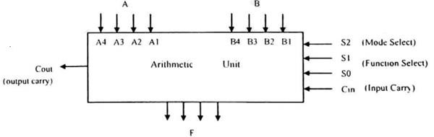
Design an arithmetic logic unit (ALU unit)?
An ALU is a multioperation, combinational logic digital function. It can perform a set of basic arithmetic operations and a set of logic operations.
The ALU has number of selection lines to select a particular operation in the unit. The selection lines are decoded within the ALU.
The four data inputs from A are combined with the four inputs B to generate an operation at the F outputs.
The mode select input S2 distinguishes between arithmetic and logic operations. The two function select inputs S1 and S0 specify the particular arithmetic or logic operation to be generated.
With three selection variables it is possible to specify four arithmetic operations and four logical operations.
The input and output carries have meaning only during an arithmetic operation. The design of ALU can be carried out in 3 stages:
Design of Arithmetic section
Design of Logic section
Modification of arithmetic section so that it can perform both arithmetic and logic operations.

Slide 9
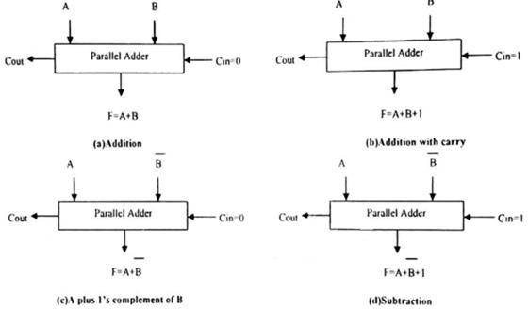
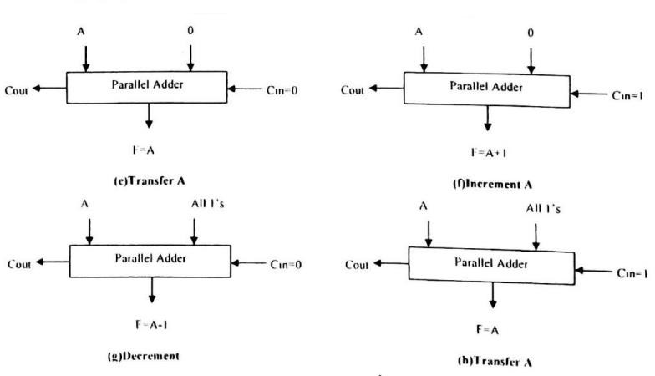
Design arithmetic Circuit?
The basic component of arithmetic section of an ALU is a parallel adder.
Parallel adder is constructed with a number of full adder circuits connected in cascade. By combining the data inputs to the parallel adder, it is possible to obtain different types of arithmetic operations.
The following figure demonstrates the arithmetic operations obtained when one set of inputs to the parallel adder is controlled externally. The no of bits in the parallel adder may be of any value.

Slide 10
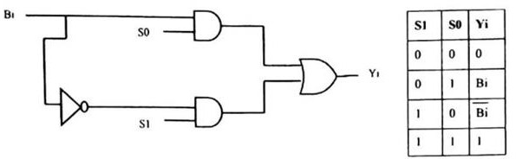
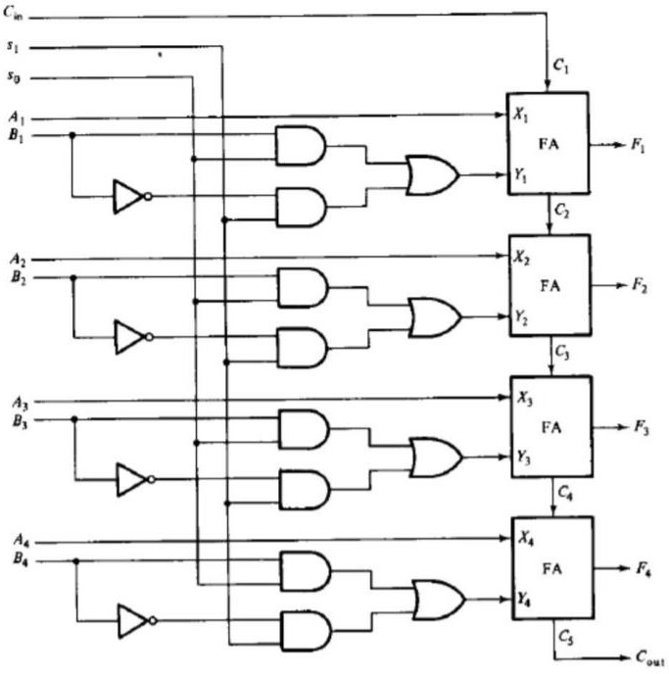
By changing the B input and Cin, we get 8 operations. So the input B is applied in four different form by using following circuit. The circuit that controls input B to provide the function is called a true/complement, one/zero element. This circuit can be shown as follows.
The A input is applied directly to the 4-bit parallel adder and the B input is modified. The resultant arithmetic circuit is shown in below figure.
The functional table for full adder circuit is shown in figure.

Slide 11
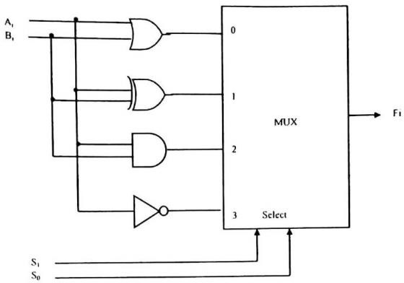
Function select |  |  | Y equals | Output equals | Function
S1 | S0 | Cin
0 | 0 | 0 | 0 | F=A | Transfer A
0 | 0 | 1 | 0 | F=A+1 | Increment A
0 | 1 | 0 | B | F=A+B | Add B to A
0 | 1 | 1 | B | F=A+B+1 | Add B to A plus 1
1 | 0 | 0 | B’ | F=A+B’ | Add 1’s complement of B to A
1 | 0 | 1 | B’ | F=A+B’+1 | Add 2’s complement of B to A
1 | 1 | 0 | All 1’s | F=A-1 | Decrement A
1 | 1 | 1 | All 1’s | F=A | Transfer A
Design Logic circuit?
The logic microoperation manipulates bits of operands separately and treat each bit as a binary variable. The 16-logic operation can be generated in one circuit and selected by means of four selection lines.
All logic operations can be obtained by means of AND, OR and NOT operations.
For three operations, we need two selection variables. But, with two selection variables, we can select four operations. So we can include one more operation XOR in our design.

Slide 12
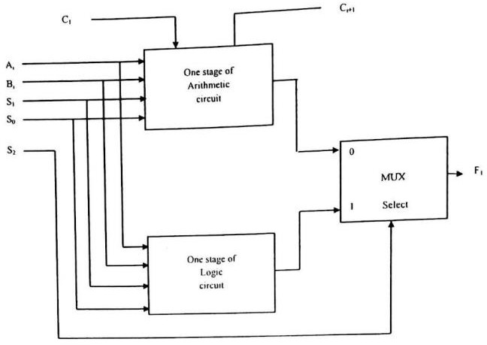
The above diagram shows design of a logic circuit. In this one typical stage designated by subscript i. The circuit must be repeated n times for an n bit logic circuit.
The four gates generate the four logic operations OR, XOR, AND and NOT. The two selection variables in the multiplexer select one of the gates for the output.
The function table lists the output logic generated as a function of two selection variables.
S1 | S0 | Output | Operation
0 | 0 | Fi=Ai+Bi | OR
0 | 1 | Fi=Ai Bi | XOR
1 | 0 | Fi=AiBi | AND
1 | 1 | Fi=Ai’ | NOT
Final design of ALU unit by combining arithmetic circuit and logic circuit

Slide 13
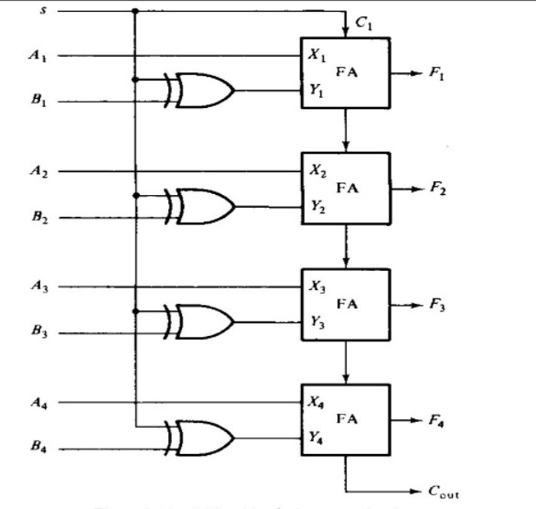
The logic circuit can be combined with the arithmetic circuit to produce one arithmetic logic unit.
Selection variables S1 and S0 can be made common to both sections provided we are using a third selection variable S2 to differentiate between the two. This configuration is illustrated in the following figure.
The outputs of the logic and arithmetic circuits in each stage go through a multiplexer with selection variable S2. When S2=0, the arithmetic output is selected, but when S2= 1, the logic output is selected.
Q) Design an adder or subtractor circuit with one selection variable ‘s’ and two inputs A and B. When s=0 the circuit performs A+B. When s=1, the circuit performs A-B by taking 2’s complement of B?

Slide 14
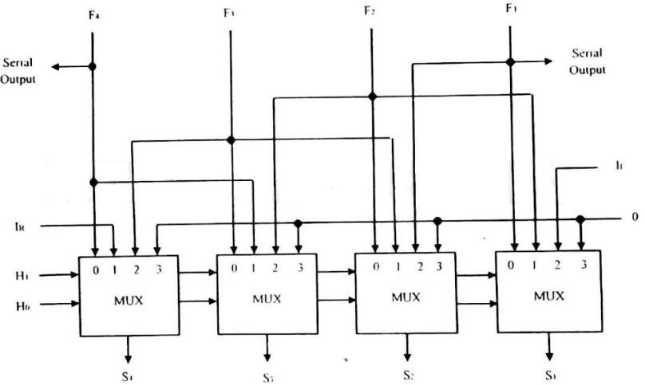
Design of Combinational Logic Shifter?
The shift unit attached to the processor transfers the output of the ALU onto the output bus. Shifter may function in 4 different ways.
The shifter may transfer the information directly without a shift.
The shifter may shift the information to the right.
The shifter may shift the information to the left.
In some cases no transfer is made from ALU to the output bus.
A shifter is a bi-directional shift-register with parallel load. The information from ALU can be transferred to the register in parallel and then shifted to the right or left.
A combinational logic shifter can be constructed with multiplexers. The following figure will show the same.
In this configuration, a clock pulse is needed for the transfer to the shift register, and another pulse is needed for the shift.
Another clock pulse may also in need of when information is passed from shift register to destination register.

Slide 15
The number of clock pulses may reduce if the shifter is implemented with a combinational circuit. In such cases, only one clock pulse is required to transfer from source register to destination register.
In a combinational logic shifter, the signals from the ALU to the output bus propagate through gates without the need for clock pulse.
Shifter operation can be selected by two variables H1H0.
If H1 H0=00, no shift is executed and the signals from F go directly to the S lines.
If H1 H0=01, shift right is executed
If H1 H0=10, shift left is executed.
If H1 H0=11, no operation
The following summarizes the operation of a shifter.
H1 | H0 | Operation | Function
0 | 0 | S←F | Transfer F to S (no shift)
0 | 1 | S←shr F | Shift right F into S
1 | 0 | S←shl F | Shift left F into S
1 | 1 | S←0 | Transfer 0’s into S
The above diagram of combinational-logic shifter shows only four stages of the shifter. The shifter must consist of n stages in a system with n parallel lines.
Inputs IR and IL serve as serial inputs for the last and first stages to fill the gap which must occur during shift right and shift left operations respectively.
A selection variable H2 may use for specifying what goes into IR and IL.
Design 4-bit Status Register?
The relative magnitude of two numbers may be determined by subtracting one number from the other and then checking certain bit conditions in the resultant difference. This status bit conditions are stored in a status register.

Slide 16
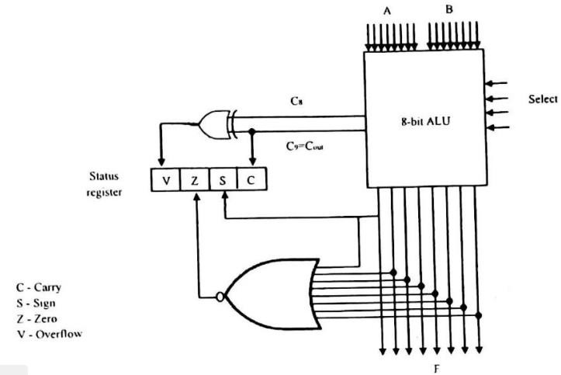
The checking conditions may vary for signed and unsigned numbers. Status register is a 4-bit register. The four bits are C (carry), Z (zero), S (sign) and V (overflow). These bits are set or cleared as a result of an operation performed in the ALU.
Bit C is set if the output carry of an ALU is 1. It is cleared if the output carry is 0.
Bit S is set to 1 if the highest order bit of the result in the output of
the ALU is 1. If the highest order bit is 0, this bit is cleared.
Bit Z is set to 1 if the output of the ALU contains all 0’s. That is if the result is zero Z bit is 1, and if the result is nonzero Z bit is 0.
Bit V is set if the exclusive OR of carries C8 and C9 is 1, and cleared otherwise. This is the condition for overflow when the numbers are in Signed 2’s complement representation.
The following figure shows the block diagram of an 8-bit ALU with a 4- bit status register.

Slide 17
After an ALU operation, status bits can be checked to determine the relationship that exist between the values of A and B. If bit V is set after the addition two signed numbers, it indicates an overflow condition.
If Z is set after an exclusive OR operation, it indicates that A=B. A single bit in A can be checked to determine if it is 0 or 1 by masking all bits except the bit in question and then checking the Z status bit.
The following table lists the various conditions for determining the relative magnitudes of A and B by checking the status bit when the operation is performed on unsigned binary numbers.
Relation | Condition of Status bits | Boolean function
A<B | C=1 | C
A<=B | C=1or Z=1 | C+Z
A>B | C=0 | C’
A>=B | C=0 or Z=1 | C’+Z
A=B | Z=1 | Z
A≠ B | Z=0 | Z’
The following table lists the various conditions for determining the relative magnitudes of A and B by checking the status bits when the operation is performed on signed binary numbers.
Relation | Condition of Status bits | Boolean function
A>B | Z=0 and (S=0,V=0 or S=1,V=1) | Z’(S ⨀V)
A>=B | Z=1 or (S=0,V=0 or S=1,V=1) | (S ⨀V)
A<B | S=1,V=0 or S=0,V=1 | (S ⨁ V)
A<=B | S=1,V=0 or S=0,V=1or Z=1 | (S ⨁ V)+Z
A=B | Z=1 | Z
A≠ B | Z=0 | Z’

Slide 18
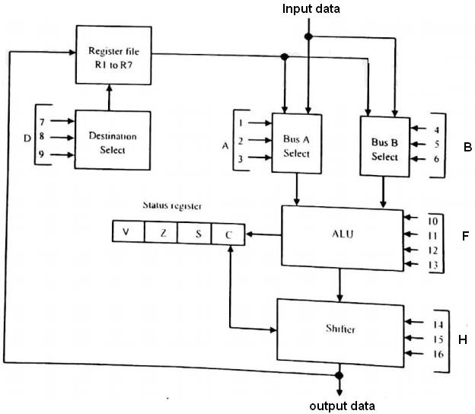
Draw and explain the block diagram of Processor Unit?
The micro-operations within the processor during a given clock cycle can be determined by the selection variables. The selection variables control the buses, the ALU, the shifter, and the destination register.
A block diagram for the processing unit is shown in the below figure.
It consists of seven registers (R1 to R7) and a status register. The output of the seven registers goes through two multiplexers to select the inputs to the ALU.
If the input is giving from any external source it can also accepting by the same multiplexers. The output from the ALU goes through a shifter and then to a set of external output terminals.
It is also possible to transfer the content from shifter to any one of the registers.

Slide 19
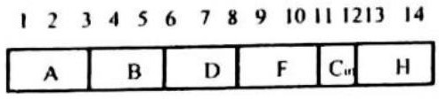
There are 16 selection variables in the unit. It can be specified by a control word. The 16 bit control word is shown in fig.
The control word is partitioned into six fields, with each field is designated by a letter name. All the fields, except Cin, have a code of 3 bits.
A selects the input register for the left side of ALU.
B selects the input register for the right side of ALU.
D selects the destination register.
F and Cin bits together selects the function for ALU.
H selects the type of shift in shifter unit.
The table given below will gives you the functions of control variables for the processor.
Binary code | Function of selection variable
 | A | B | D | F with Cin=0 | F with Cin=1 | H
000 | Input data | Input data | None | A,C←0 | A+1 | No shift
001 | R1 | R1 | R1 | A+B | A+B+1 | Shift right
010 | R2 | R2 | R2 | A-B-1 | A-B | Shift left
011 | R3 | R3 | R3 | A-1 | A,C←1 | 0’s to o/p bus
100 | R4 | R4 | R4 | AVB | ………. | …………
101 | R5 | R5 | R5 | A⨁B | ………. | Calculate right with C
101 | R6 | R6 | R6 | A B | ……… | ………….
111 | R7 | R7 | R7 | A’ | ……….. | Calculate left with C

Slide 20
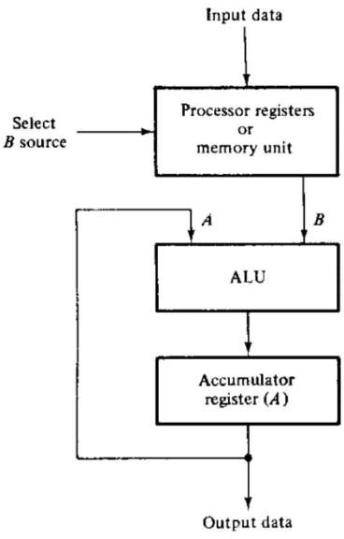
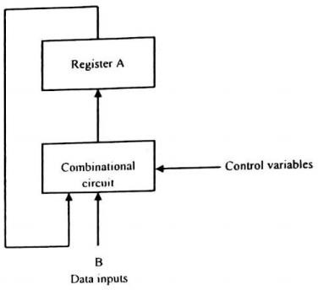
Design of Accumulator?
Accumulator register is a multipurpose register capable of performing many micro-operations. The organization of a processor unit with an accumulator register is shown below.
The ALU associated with the register maybe constructed as a combinational circuit. In this configuration, the accumulator register with parallel load is connected to the ALU.
The block diagram of the accumulator that forms as sequential circuit is shown below:

Slide 21
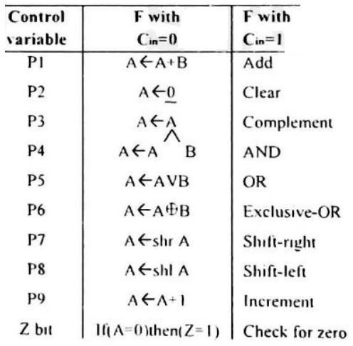
Accumulator can also perform data processing operations. Total of nine operations are considered here for the design of accumulator circuit.
These operations are described below.
Design Procedure
Add B to A (P1)
Add micro-operation is initiated when control variable P, is 1. To perform addition operation, accumulator can use a parallel adder composed of full adders. The full adder in each stage 1 will accept the input and and a previous carry bit C1.
Sum bit is transferred to flip flop Ai, and output carries Ci+1 is transferred to the next stage as input carry of that stage.
The state table of a full adder, when considered as a sequential circuit is shown below.

Slide 22
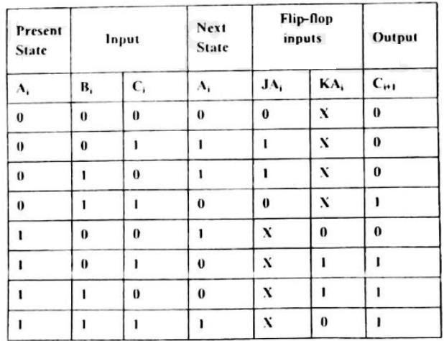
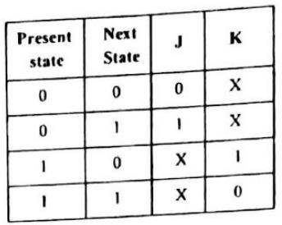
The excitation input for the JK flip flop is shown below for reference.
According to these values the above flip flop inputs are set. The flip flop input functions and the Boolean functions for the output are simplified in the maps as shown in fig.

Slide 23
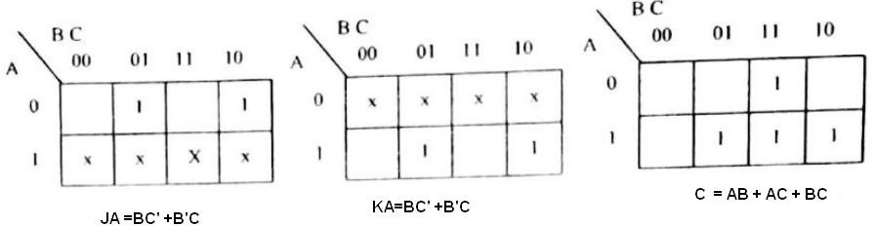
These two equations should affect the flip flop only when PI is enabled. Therefore, they should be ANDed with control variable P, Then the equation becomes.
JAi =B1C1’P1+B1’C1P1 KAi = B1C1’P1+B1’C1P1 Ci+1=A1B1+A1C1+B1C1
Clear (P2)
Control variable P2 clears all flip flops in register A. To cause this transition in a JK flip flop. we need only apply control satiable P2 to the K input of the flip flop.
The J input will he assumed to be 0 if nothing is applied on it. The input functions can be written as.
JAi =0 KAi =P2
COMPLEMENT(P3)
To cause this transition in a JK flip-flop we need to apply p3 to both J and K inputs.
JAi =P3 KAi =P3

Slide 24
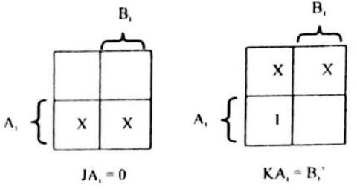
AND (P4)
This micro operation is initiated with control variable P4.This operation performs the logic AND operation between Ai and Bi and transfers the result to A.
The excitation table for this operation is as shown below.
Present State | Input | Next State | Flip-flop Inputs
Ai | Bi | Ai | JAi | KAi
0 | 0 | 0 | 0 | X
0 | 1 | 0 | 0 | X
1 | 0 | 0 | X | 1
1 | 1 | 1 | X | 0
The next state of Ai will be 1 only when the present state of Ai and data input Bi, is 1. The flip flop input functions can be simplified with the maps and the equations can be written as:
JAi =0 KAi =Bi’
By including the control variable p4, the equation can be rewritten as:
JAi =0 KAi =Bi’P4

Slide 25
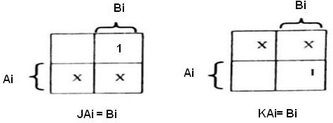
OR (P5)
Control variable P5, initiates the logic OR operation between Ai and Bi The result is transferred to Ai.
The excitation table for this operation is as shown below.
Present State | Input | Next State | Flip-flop Inputs
Ai | Bi | Ai | JAi | KAi
0 | 0 | 0 | 0 | X
0 | 1 | 1 | 1 | X
1 | 0 | 1 | X | 0
1 | 1 | 1 | X | 0
The simplified equations in the maps dictate that the J input be enabled when Bi =1. When Bi=0, the present state and next state of Ai are the same.
When Bi=1, the J input is enabled and the next state of Ai, becomes 1. Input functions for the OR micro operation are:
JAi =BiP5
KAi =0
Exclusive-OR (P6)
Control variable P6 initiates the logic Exclusive-OR operation between Ai and Bi. The result is transferred to Ai.
The excitation table and map simplification is as shown below.

Slide 26
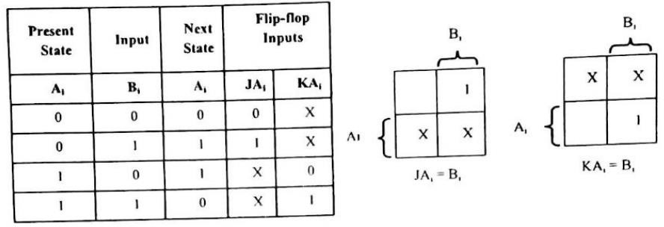
The flip flop input functions are written as:
JAi =BiP6 KAi = BiP6
Shift-right (P7)
Control variable P7 initiates the shift operation of Ai register one bit to the right. That is the value of flip flop Ai+1 is transferred to flip flop Ai.
The flip flop input functions can be written as:
JAi = Ai+1 P7 KAi = Ai+1 P7
Shift-left (P8)
Control variable P8 initiates the shift operation of Ai register one bit to the left. That is, the value of flip flop Ai-1 is transferred to flip flop Ai .
The flip flop input functions can be written as:
•
•
JAi = Ai-1 P8 KAi = Ai-1 P8
9. Increment (P9)

Slide 27
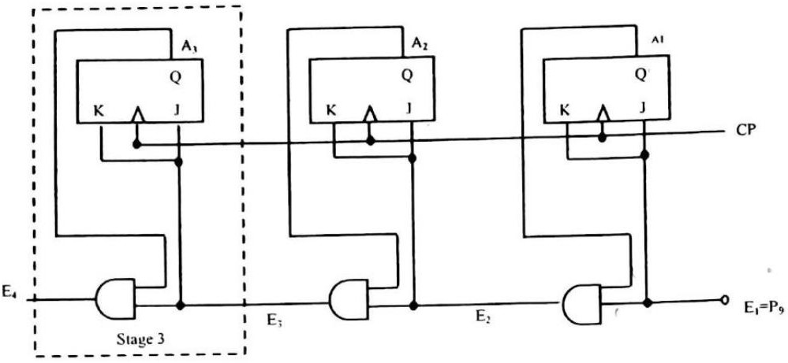
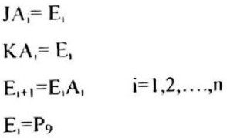
These operations increment the content of A register by one. The register behaves likes a synchronous binary counter with P9 enabling the count.
A 3 bit synchronous counter is shown in the following figure.
The Boolean function for a typical stage can be written as:
Check for Zero (Z)
Variable Z is an output from the accumulator. This variable can be used to indicate a zero content in the A register.
All the flip flops in the accumulator is cleared Z variable will be set to 1. When a flip flop is cleared, its complement output Q' is equal to 1.
The following figure shows the first three stages of the accumulator that checks for zero content.

Slide 28
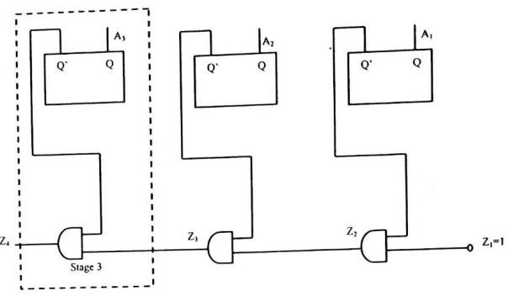

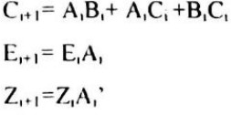
Each stage generates a variable Zi+1 by ANDing the complement output of Ai to an input variable Zi. In this way, a chain of AND gates through all stages will indicate if all flips ate cleared.
The Boolean function for a typical stage can be expressed as:
Zi+1 = ZiAi i=1,2,3…………………n Z1=1
Zn+1=Z
One stage of Accumulator
Combining all the input functions for the J and K inputs flip flop A1 produces a composite set of input Boolean functions for a typical stage.
Each stage in the accumulator must produce the carry for the next stage.
The logic diagram for one typical stage of the Accumulator is shown below:

Slide 29
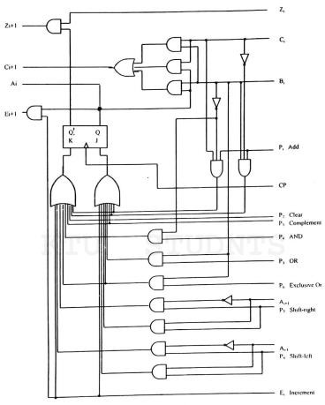
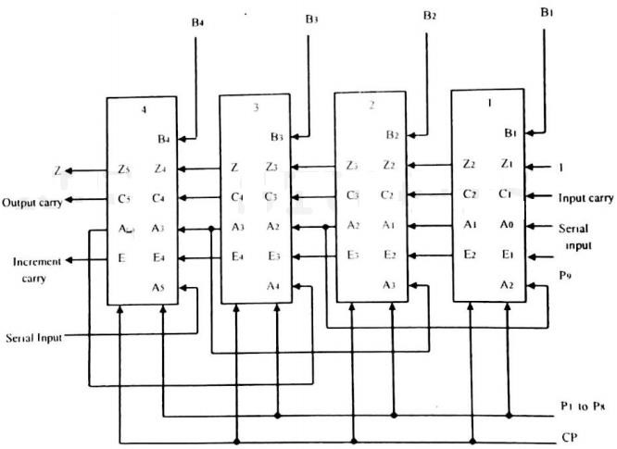
Complete Accumulator
For a complete accumulator there will be n stages like this. The inputs and outputs of each stage can he connected in cascade to form a complete accumulator.

Slide 30
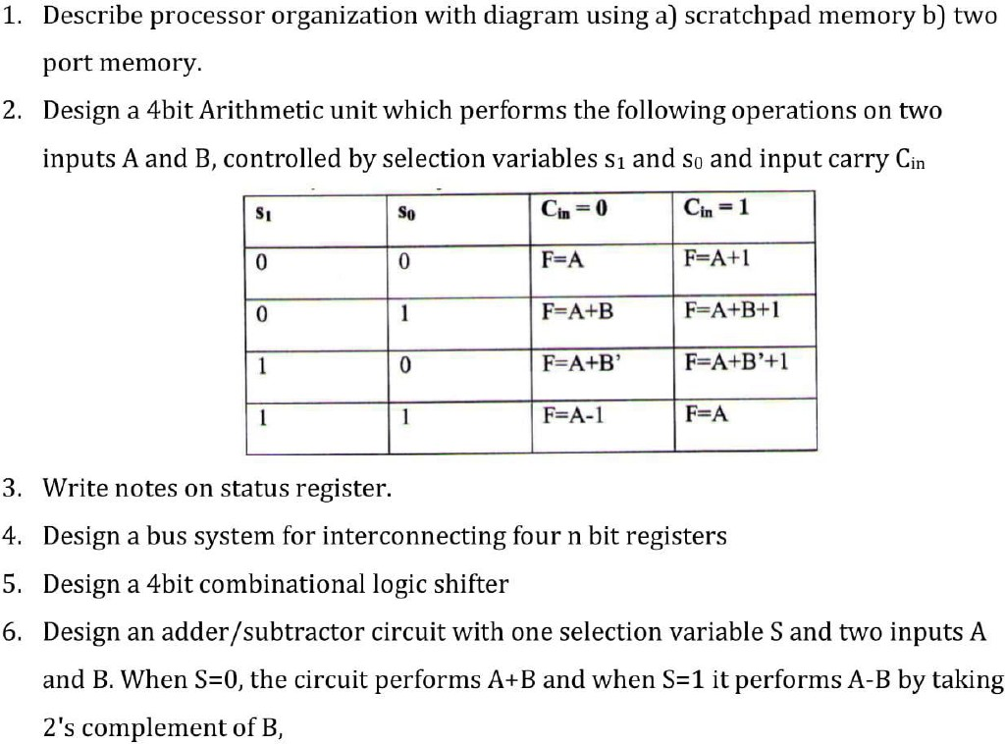
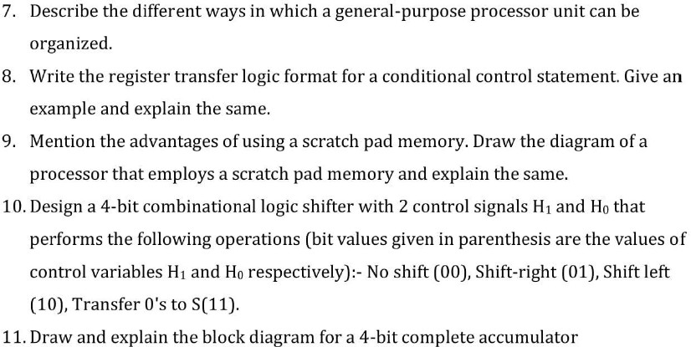
PREVIOUS YEAR UNIVERSITY QUESTION

Slide 31
